Slide 1
Experimental Search for Physics beyond the SM:
Strong CP (non-)Violation, EDMs, Axions / hidden Photons, and other beyond the SM particles from the Sun.
K. Zioutas
University of Patras / Greece
Lecture 1
➔ exercises?
➔ Ongoing research!
Spring Blockcourse 2011
Dresden
8th- 10th March 2011

Slide 2
The open question since Fritz Zwicky (1933) is:
What is “dunkle Materie” made of?
axions and WIMPs ... WISPs → more

Slide 3

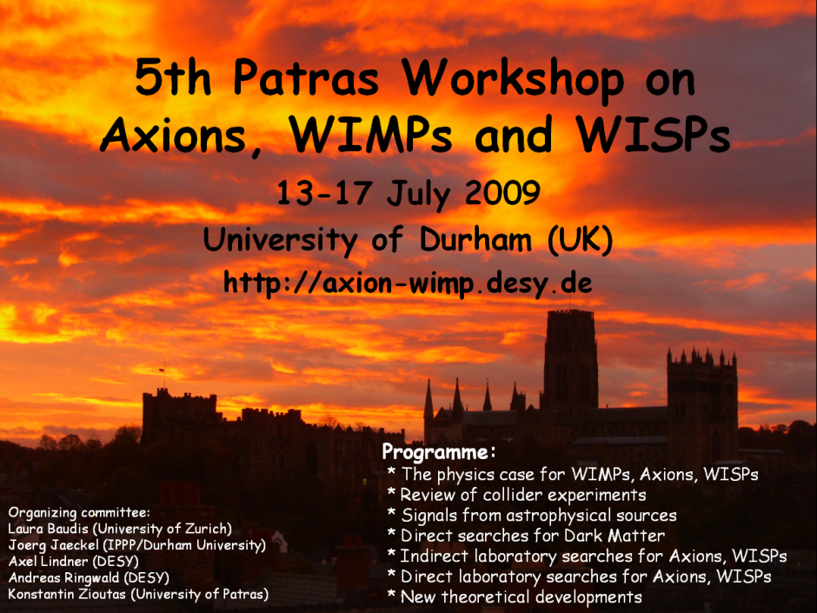
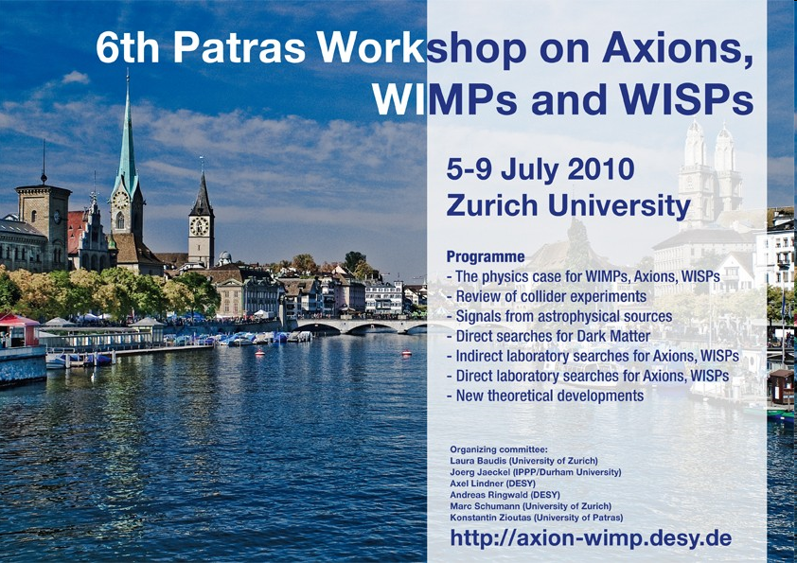

Annual Workshops

Slide 4
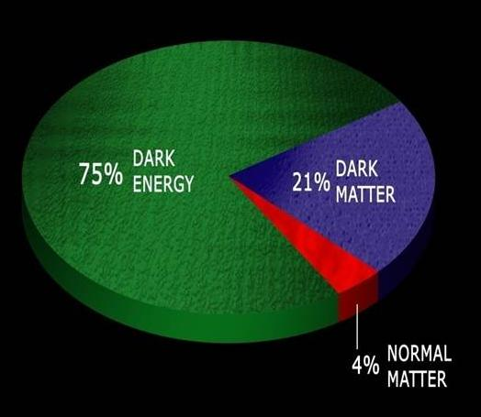
Dark Matter: Something Invisible?
Notes:
Newton’s law can very reliably predict planetory velocities. However, on larger galaxy scale, observed velocity implies a lot of missing mass.

Slide 5
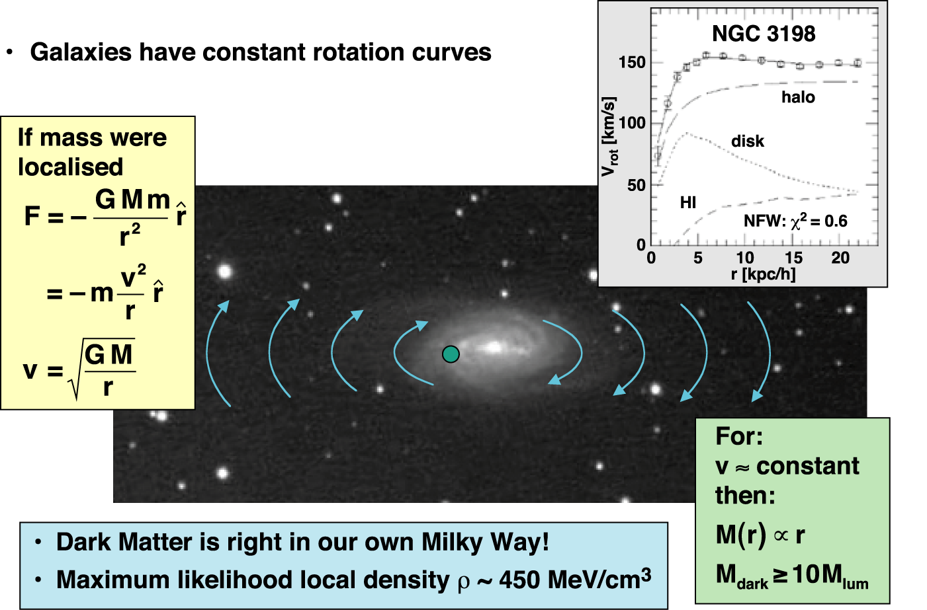
Evidence for dark matter: Rotation curves of spiral galaxies

Slide 6
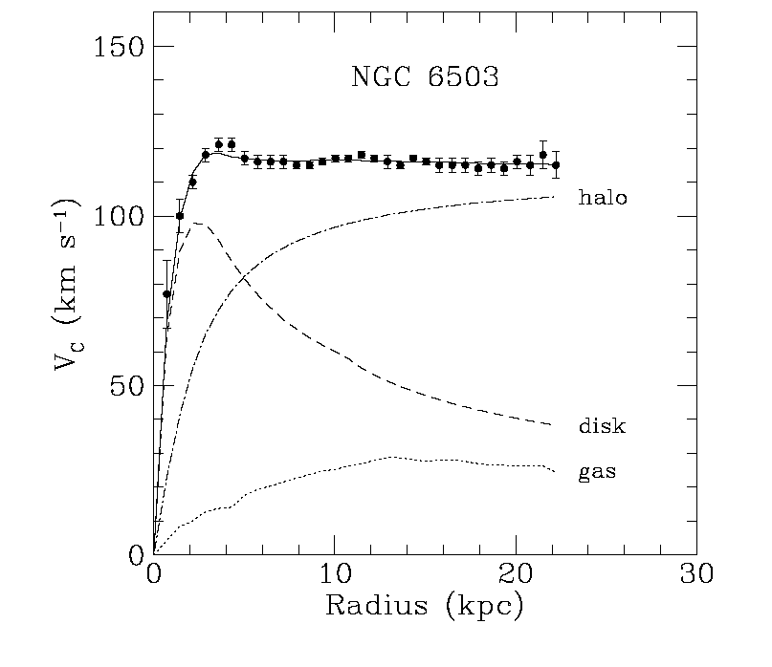
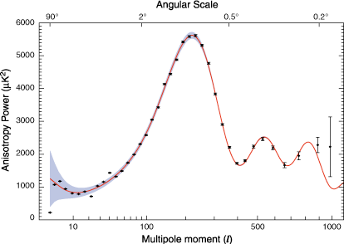
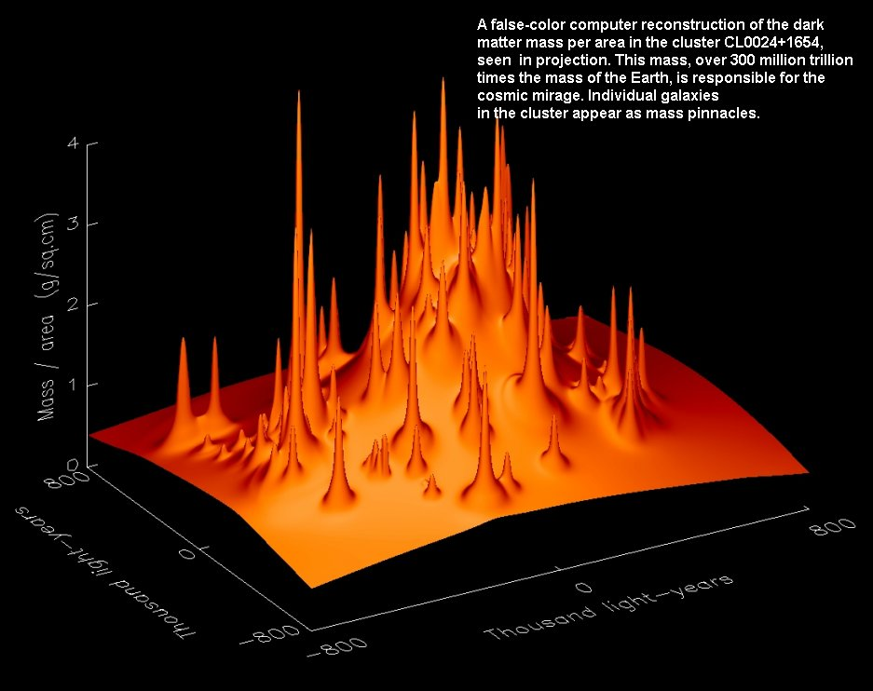
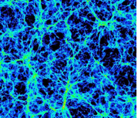
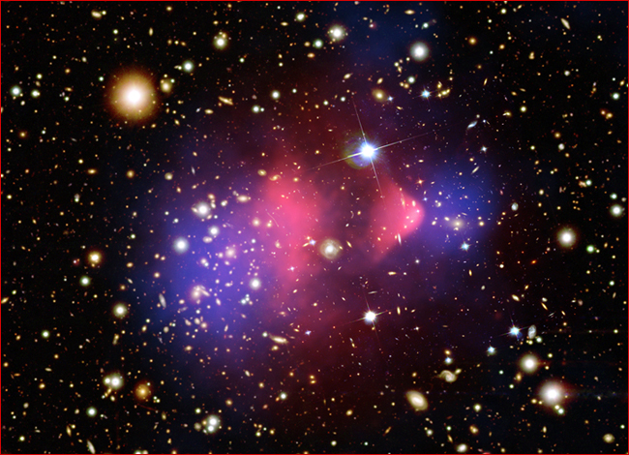
Astrophysics Observations of Dark Matter
may explain observed Gravitational effects at many scales
Rotation Curves of Galaxies
CMB
Galaxy Cluster
Large Scale Structure
Bullet Cluster

Slide 7
…motivation?
Gravity produced by dark matter is an
essential ingredient in galaxy formation
+
its dynamics.
Detection of:
Dark matter
#
Dark matter candidates, e.g. from the Sun, @ lab, ...
➔ a real challenge
→ fundamental new physics!?

Slide 8
Dark Matter could be Axions!
Due to their non-thermal production in the universe light axions would constitute
cold dark matter (CDM).
Such axions couple extremely weakly to matter:
the “invisible” axion.
The axion was not invented to
solve the Dark Matter problem!
H. Baer, presentation at 5th Patras Workshop on Axions, WIMPs and WISPs, 2009

Slide 9
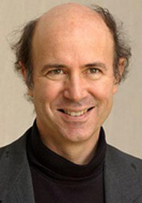
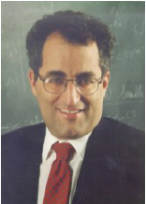
On axion as dark matter candidate
Wilczek conclusion (“Physics Today”):
I’m much more optimistic about the dark matter problem.
Here we have the unusual situation that two good ideas
exist… wimps and axions.
Witten conclusion (“Axions in String Theory”):
Axions are ubiquitous in string theory; as necessary as
gravitons. Couplings and masses of dark matter QCD axions
are tightly constrained: Allowed couplings are within a range
of x7 and the mass is constrained to the two decades
10⁻⁶ –10⁻⁴ eV.
The axion remains a very attractive dark-matter candidate.
➔ Axion experiments are relatively inexpensive!!
http://www.physics.ucla.edu/hep/dm10/talks/carosi.pdf

Slide 10


The strong CP problem → origin?
The QCD Lagrangian :
  L_{pert} ⇒ numerous phenomenological successes of QCD.
  G is the gluon field-strength tensor
  θ-term → a consequence of non-perturbative effects
  → implies violation of CP symmetry
  → would induce EDMs of strongly interacting particles
Experimentally ➔ CP is not violated in QCD → the neutron EDM d_{n} < 10⁻²⁵ e cm ⇒ θ < 10⁻¹⁰
⇒ why is θ so small? ➔ the strong-CP problem
➔ the only outstanding flaw in QCD
➔ To solve the strong-CP problem, Peccei-Quinn introduced a global U(1)_{PQ} symmetry broken
at a scale f_{PQ}, and non-perturbative quantum effects drive θ → 0 ➔ “CP-conserving value”
and also generate a mass for the axion :
The most natural solution to explain this problem is to introduce a new field in the theory, the axion field, which involves a new pseudo scalar particle. The AXION.
➔ All the axion couplings are inversely proportional to f_{PQ} .

Slide 11
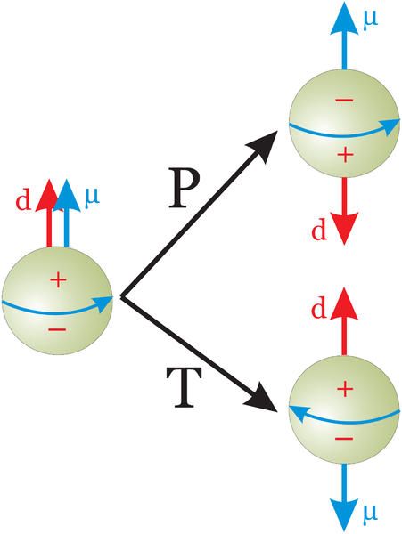
A Flaw and fundamental Properties of Nature
Electric and magnetic dipole moments of the neutron are related to fundamental symmetries:
P (parity), T (time reversal)
and C (charge conjugation) .
C
P
Neutron
Antineutron
Antineutron
http://en.wikipedia.org
If the neutron has an electric dipole moment
in addition to the measured magnetic dipole moment, CP is not conserved.
Both moments would change from parallelism to anti-parallelism.
The strong interaction conserves CP ↔ no nEDM

Slide 12
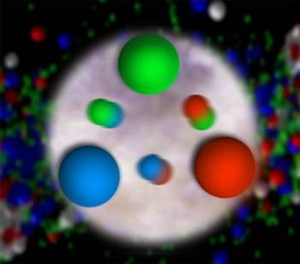
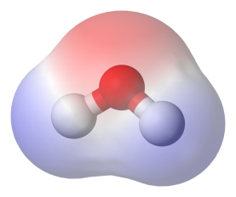
More Motivation: A Flaw in the Standard Model?
The neutron’s strange property:
It consists of three charged quarks, but does not show any static electric dipole moment.
Why do the wave functions of the three quarks exactly cancel
out any observable static charge distribution in the neutron?
http://www.lbl.gov/Science-Articles/Archive/sabl/2006/Oct/3.html
http://en.wikipedia.org

Slide 13
More Motivation: A Flaw in the Standard Model?
Naively one expects for the neutron electric dipole moment:
d_{n-QCD} ∼ 10⁻¹⁵ e·cm.
The data show: d_{n-data} < 10⁻²⁶ e·cm!
How to explain the difference of at least 11 orders of magnitude?
∼ 10⁻¹⁵ cm
http://www.lbl.gov/Science-Articles/Archive/sabl/2006/Oct/3.html

Slide 14
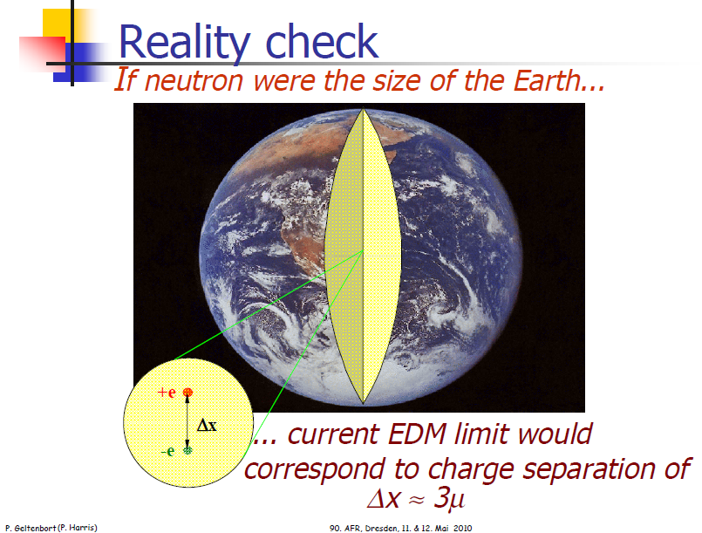

Slide 15
Detour: CP is not only an academic Question
CP violation is essential to explain why in the very early universe the ratio of matter to antimatter was
→ Matter/Antimatter = 1+10⁻⁹
→ all (~4%) what we see is made from this 10⁻⁹ fraction.
In principle QCD allows for CP, but experiments show: CP is conserved.
http://www.weltmaschine.de

Slide 16
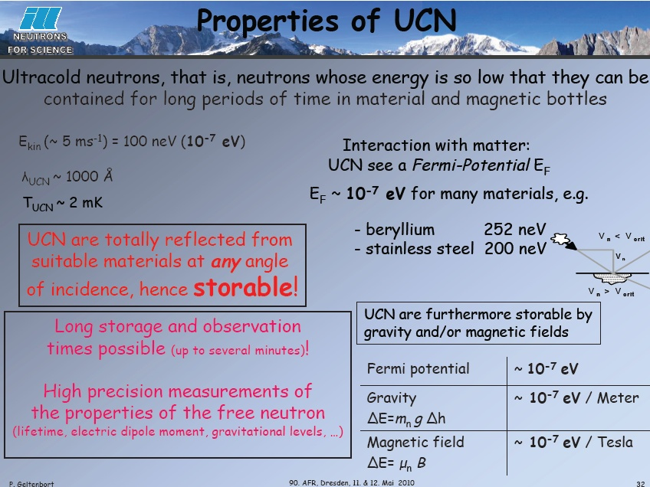
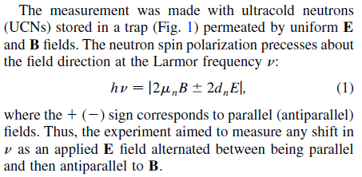

Slide 17
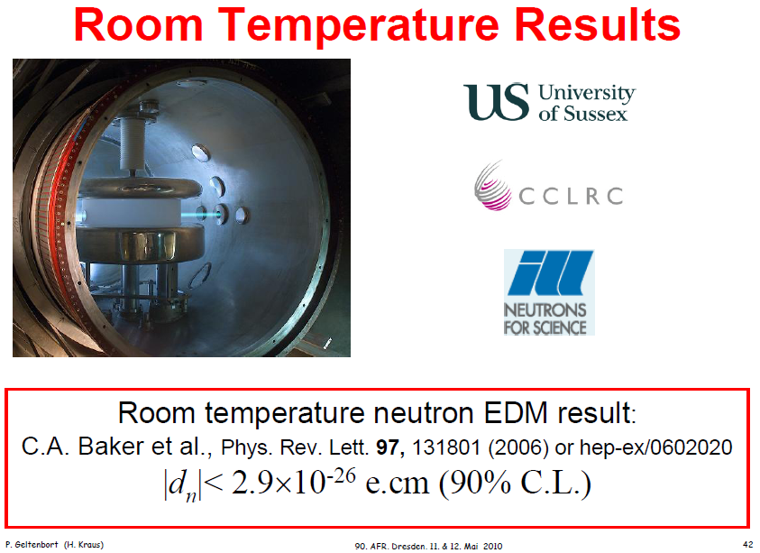

Slide 18
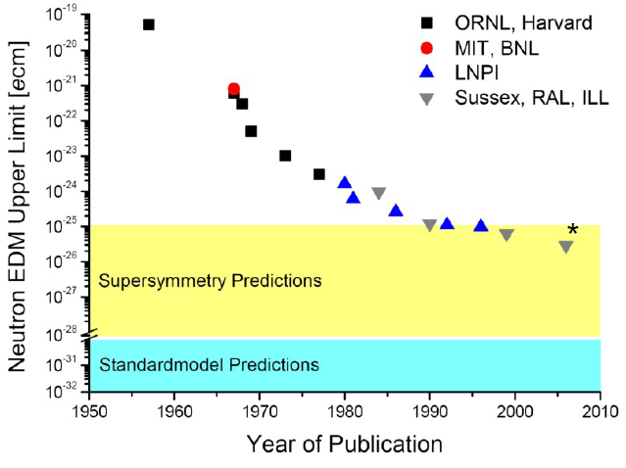
nEDM
http://www.physics.ucla.edu/hep/dm10/talks/carosi.pdf
C.A. Baker, etal., Improved Experim. Limit on the nEDM, Phys. Rev. Lett. 91 (2006) 131801.
http://link.aps.org/abstract/PRL/v97/e131801 .

Slide 19
Thus ....
... CP violation in Standard Model generates very small nEDM.
→ Beyond the Standard Model contributions tend to be much bigger.
➔ Neutron a very good system to look for CP violation beyond the SM
more? pEDM, dEDM, ...
d_{EDM} x E

Slide 20
QM: a non-degenerate system with Spin is defined by the spin vector.
+
-
If the particle has an EDM, its vector needs to be aligned with the spin vector, locked to its direction, i.e. it needs to choose either along or opposite but not both (non-degenerate).
“CP-Violation Without Strangeness”, Khriplovich/Lamoreaux.

Slide 21
A permanent EDM violates both T & P symmetries:
+
T
-
+
-
P
-
+
From T-violation and CPT conservation → CP-violation.

Slide 22
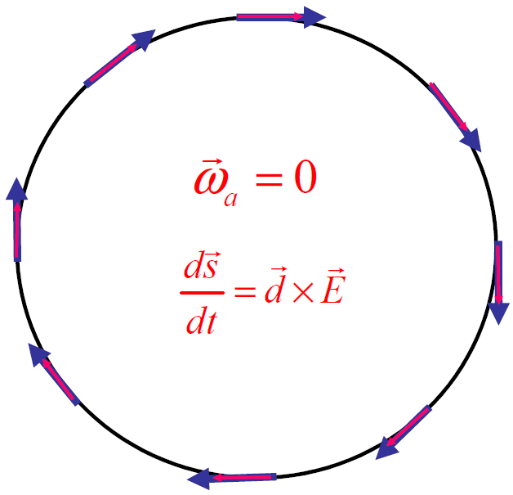
Storage Ring EDM experiments
High beam intensities (10¹⁰-10¹¹pps), with high polarization (>0.8), and low emmittance are currently available
Large electric fields are possible (10-20MV/m)
Spin coherence time ~10³s are possible
High efficiency, large analyzing power (~0.5) polarimeters are available for the proton and deuteron at ~1 GeV/c momentum making possible the next sensitivity level
Direct access to charged
particle EDMs
Yannis Semertzidis, BNL
Notes:
22

Slide 23
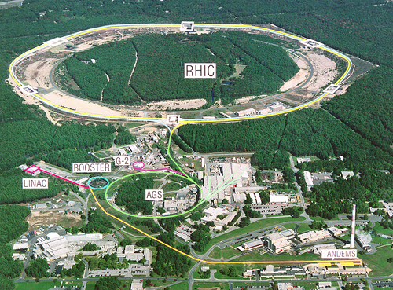
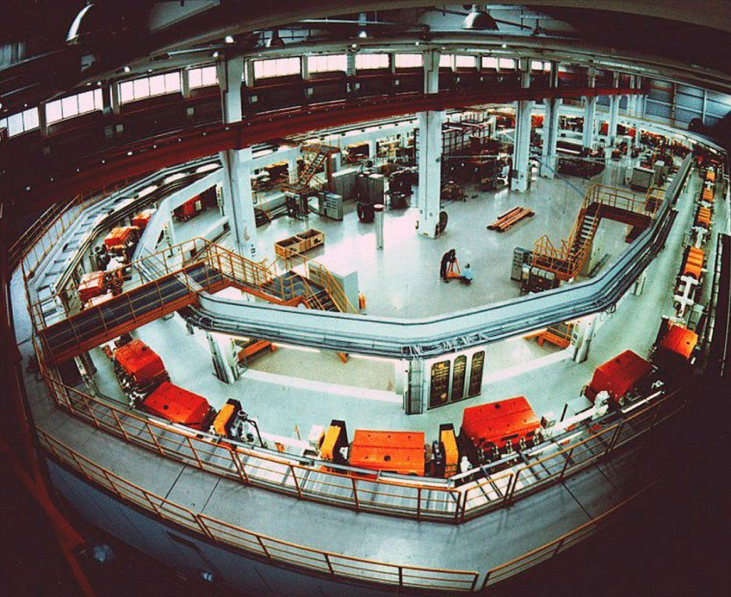
Two labs to host the EDM experiments
BNL, USA:
proton “magic” ring
COSY/IKP, Germany: deuteron ring
Yannis Semertzidis, BNL

Slide 24
Freezing the horizontal spin precession
The spin precession is zero at “magic” momentum
(0.7 GeV/c for protons, 3.1GeV/c for muons,…)
The “magic” momentum concept was first used in the last muon g-2 experiment at CERN and BNL.
Yannis Semertzidis, BNL

Slide 25
When P=P_{magic} the spin follows the momentum
No matter what the E-field value is, the spin follows the momentum vector creating an ideal Dirac-like particle (g=2)
E
E
E
E
Yannis Semertzidis, BNL
Notes:
Yannis Semertzidis, BNL
25

Slide 26
EDMs of hadronic systems are mainly sensitive to
Theta-QCD (part of the SM)
CP-violation sources beyond the SM
A number of alternative simple systems could provide invaluable complementary information (e.g. neutron, proton, deuteron,…).
Yannis Semertzidis, BNL

Slide 27
Hadronic EDMs and axions
~
Order of magnitude estimation of the neutron EDM:
M. Pospelov, A. Ritz,
Ann. Phys. 318 (2005) 119.
Why Θ so small? P.Q. symmetry → Axions!!!!!!!
Yannis Semertzidis, BNL
Notes:
From dimensional analysis

Slide 28
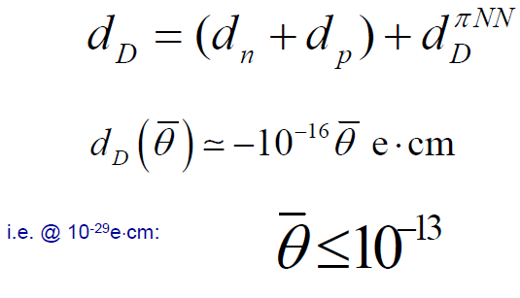
Deuteron EDM sensitivity

Slide 29
Quark EDM and Color EDMs
i.e. D and neutrons are sensitive to different linear combination
of quarks and chromo-EDMs… → D is ~20x more sensitive!!
Yannis Semertzidis, BNL
Notes:
Yannis Semertzidis, BNL. ICHEP02, 31 July 2002
29

Slide 30
Physics reach of pEDM
Sensitivity to SUSY-type new Physics:
The pEDM at 10⁻²⁹e∙cm has a reach of >300TeV →
an unprecedented sensitivity level.
→ The dEDM sensitivity is similar.
Yannis Semertzidis, BNL
Notes:
30

Slide 31
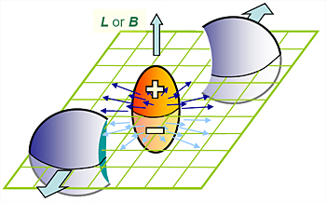
RHIC: Heavy ion collisions
→ EDM of high T QCD matter!?
Particles carrying charges of opposite sign will be emitted into different hemispheres .
Fluctuations of the charge symmetry with respect to the collision plane, which have been observed by STAR, may therefore be a signature of local parity violation.
Schematic view of the charge separation along the system's orbital angular momentum.
DE Kharzeev, Phys. Lett. B633 (2006) 260
Y. Semertzidis / BNL
http://physics.aps.org/view_image/3187/large/1
http://physics.aps.org/viewpoint-for/10.1103/PhysRevLett.103.251601
http://www.bnl.gov/today/story.asp?ITEM_NO=1588
http://www.pa.msu.edu/conf/wwnd2010/talks/kharzeev.pdf

Slide 32
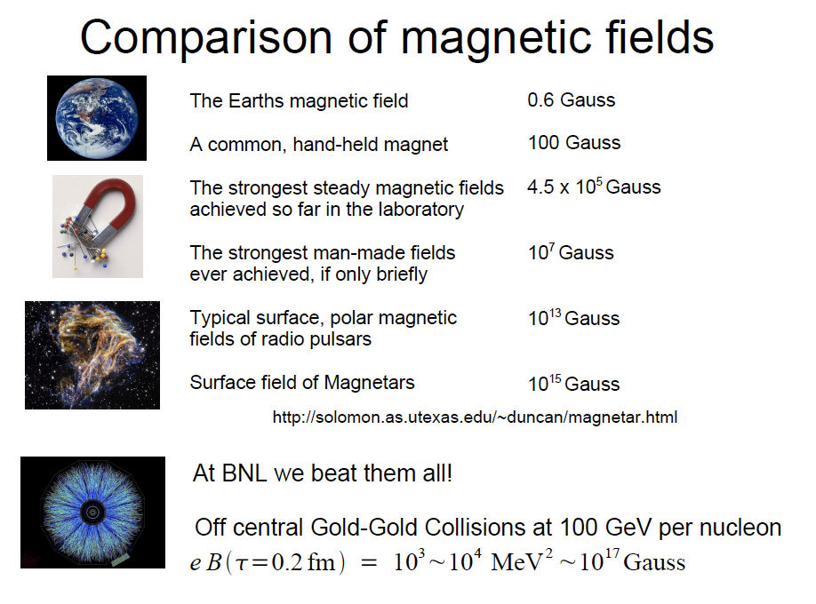
~10¹⁷ Gauss
Yannis Semertzidis, BNL

Slide 33
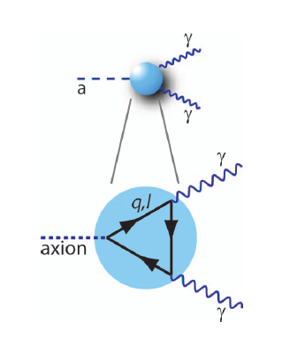
Properties of the QCD Axion
The axion behaves like a light cousin of the π⁰.
It couples to two photons.
Mass and the symmetry breaking scale f_{a} are related:
m_{a} = 0.6eV · (10⁷GeV / f_{a})
The coupling strength to photons is
g_{aγγ} = α·g_{γ} / (π·f_{a}), where g_{γ} is model dependent and O(1).
The axion abundance in the universe is
Ω_{a} / Ω_{c} ∼ (f_{a} / 10¹²GeV)^{7/6}.
f_{a} < 10¹²GeV for m_{a} > μeV
The Search for Axions, Carosi, van Bibber, Pivovaroff, Contemp. Phys. 49, No. 4, 2008

Slide 34
Alluring and challenging ….
The axion could solve two long-standing quests simultaneously:
It could explain the CP conservation of QCD (nEDM)
A QCD axion in the mass region of 10⁻² to 10⁻¹ meV would be a “perfect” cold Dark Matter candidate.
Unfortunately this implies a very weak coupling to other stuff:
10⁹GeV < f_{a} < 10¹²GeV, compare electroweak scale of O(100 GeV)!
10⁻¹⁴ GeV⁻¹ < g_{aγγ} < 10⁻¹² GeV⁻¹.
How to search for such an “invisible” axion?
This reminds on the history of the “undetectable“ neutrino postulated by Pauli in 1930 and discovered more than 20 years later.
Axel Lindner / DESY

Slide 35

Axion’s radiative decay
➔ a quasi stable particle!
... “force” it to decay!
inside E / B
→ See J. Redondo
in ~all present experiments
in nature? ... Sun, ..., outer Space?

Slide 36
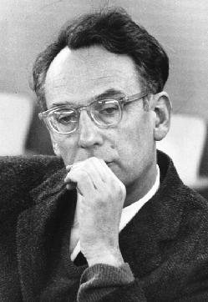
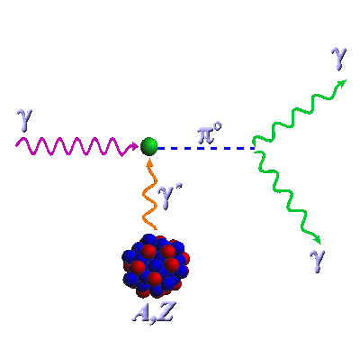
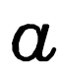
The Primakoff Effect 1951
H. Primakoff
axion
γ
Behind all present axion work!
×
B

Slide 37
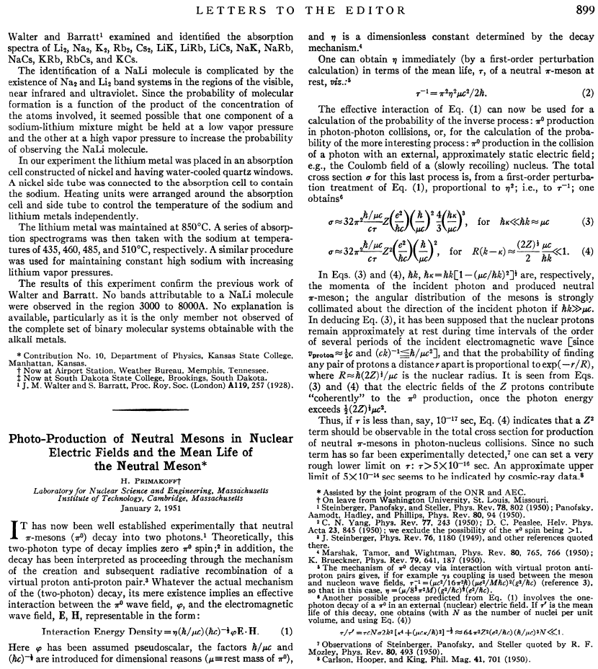
http://prola.aps.org/pdf/PR/v81/i5/p899_1

Slide 38
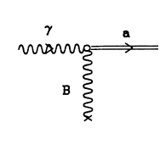
The Primakoff Effect
Magnet
γ∗
γ
a
≡
B
∴
Classical EM field
Sea of virtual photons
Primakoff Effect

Slide 39
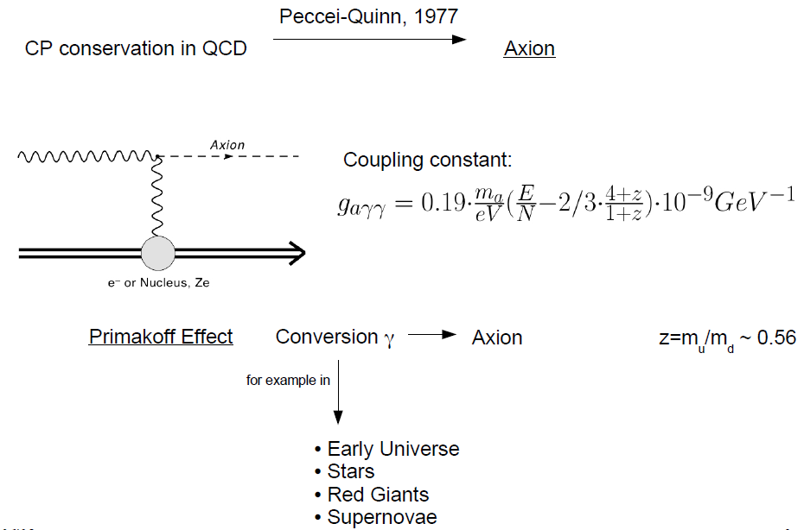
Axion basics
Primakoff - effect
→ sun
http://www.mpi-hd.mpg.de/gerda/lngs08/lngs08_slides/wednes/LNGS08axionsearch.pdf

Slide 40
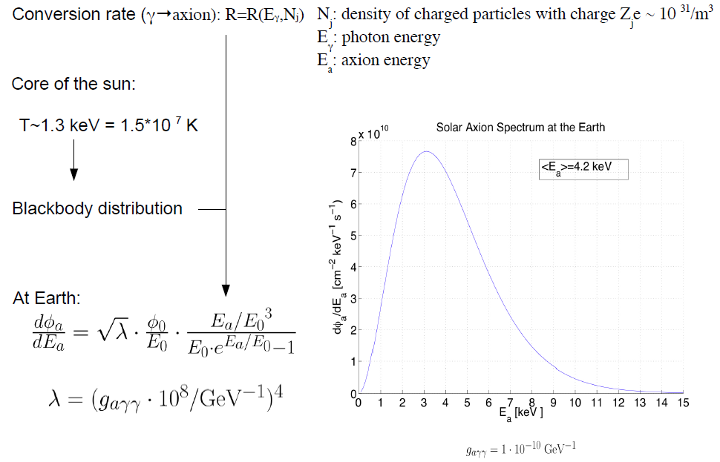
Solar Axions
Screening effect
at low energies
~25x less!!
http://www.mpi-hd.mpg.de/gerda/lngs08/lngs08_slides/wednes/LNGS08axionsearch.pdf

Slide 41
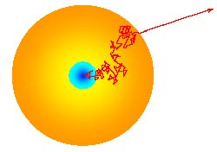
Visible light
ν’s
Axions
Chameleons
Paraphotons
...
WISPs
more?

Slide 42


The Axion stellar search
Astrophysical and cosmological bounds on axion properties
The existence of the axion would affect physics.
It is possible to constrain axion properties (i.e., coupling strength) from:
Sun lifetime
Stellar evolution. Globular clusters
White dwarf cooling
Supernova physics. Effect on neutrino burst duration
5. The axion or other WISP could be related to other physics problems
→ Solar corona heating problem and the unexpected solar X-rays

Slide 43
overlooked?
Solar energy is created within the core of the Sun.
→ Nuclear reactions: 4p = 1α
The one He is about .7 % less massive than the 4p.
Energy generated in the Sun's core takes ~10⁶ years
to reach its surface.
700 million tons H / s are converted into He.
➔ 5 million tons of pure energy is released ⬅
➔ ~100 “ktons” of axions / s ⬅
http://www.solarviews.com/eng/sun.htm

Slide 44
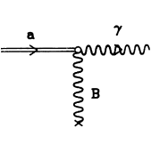
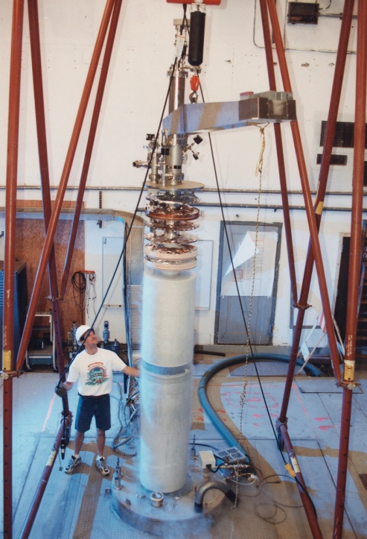
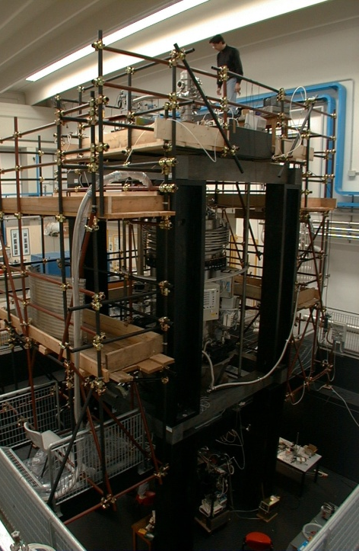
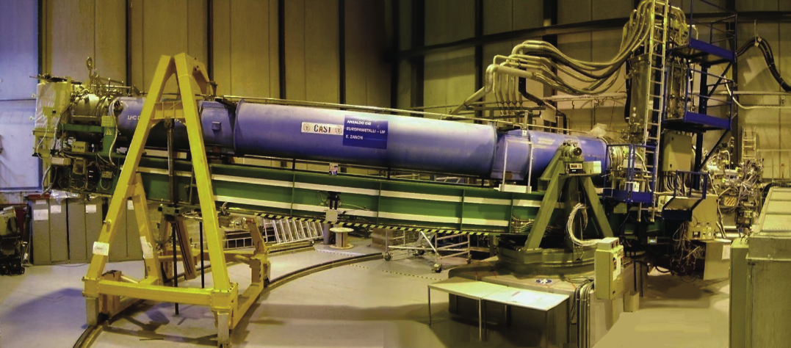
Axion-photon mixing
[P. Sikivie, PRL 51, 1415 (1983)]
Dark matter
Solar
Laboratory
Coherent mixing of axions and photons over large spatial regions of strong magnetic fields (a sea of virtual photons) compensates for the extraordinarily small value of g_{aγγ}
See Raffelt & Stodolsky for general treatment of axion-photon mixing – PRD 37, 1237 (1988)

Slide 45
Axion basics
Light cousin of π⁰: J^{π}= 0–
10^{–8}
γ
a
10^{–10}
Horizontal Branch
Star limit
g_{aγγ} (GeV^{–1})
10^{–12}
Ω_{a} > 1
Sn1987a
m_{a} , g_{aii} ∝ f_{a}^{–1} ∴ g_{aγγ} ∝ m_{a}
10^{–14}
Axion
models
Ω_{a} ∝ f_{a}^{7/6} → m_{a} > 1 μeV
10^{–16}
Sn1987a ν pulse precludes
NN→NNa for m_{a}~10^{–(2–0)}eV
10^{–6}
10^{–4}
10^{–2}
10⁰
m_{a} [eV]
Horizontal Branch Stars
preclude g_{aγγ} > 10^{–10} GeV^{–1}
G.G. Raffelt “Stars as Laboratories for
Fundamental Physics” U. Chicago Press (1996)
Good news – Parameter space is bounded
Bad news – All couplings are extraordinarily weak

Slide 46
With axion:
New elementary particle
Solves the strong CP problem
New solar physics
→ solar mysteries
➔ how to detect the axion?

Slide 47
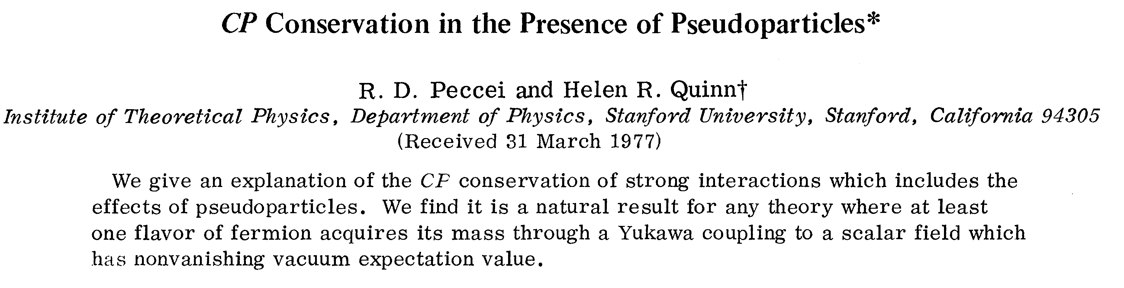
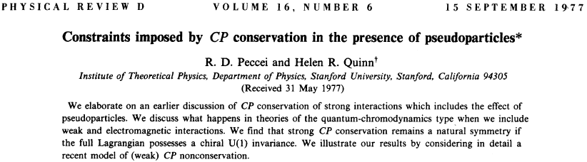
http://prl.aps.org/pdf/PRL/v38/i25/p1440_1
http://prd.aps.org/pdf/PRD/v16/i6/p1791_1

Slide 48
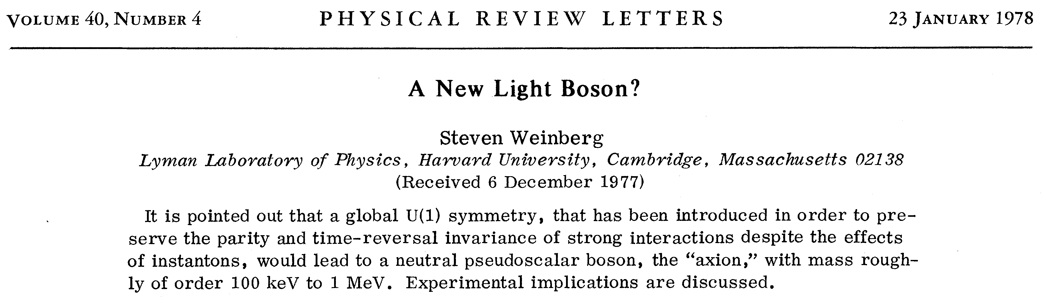
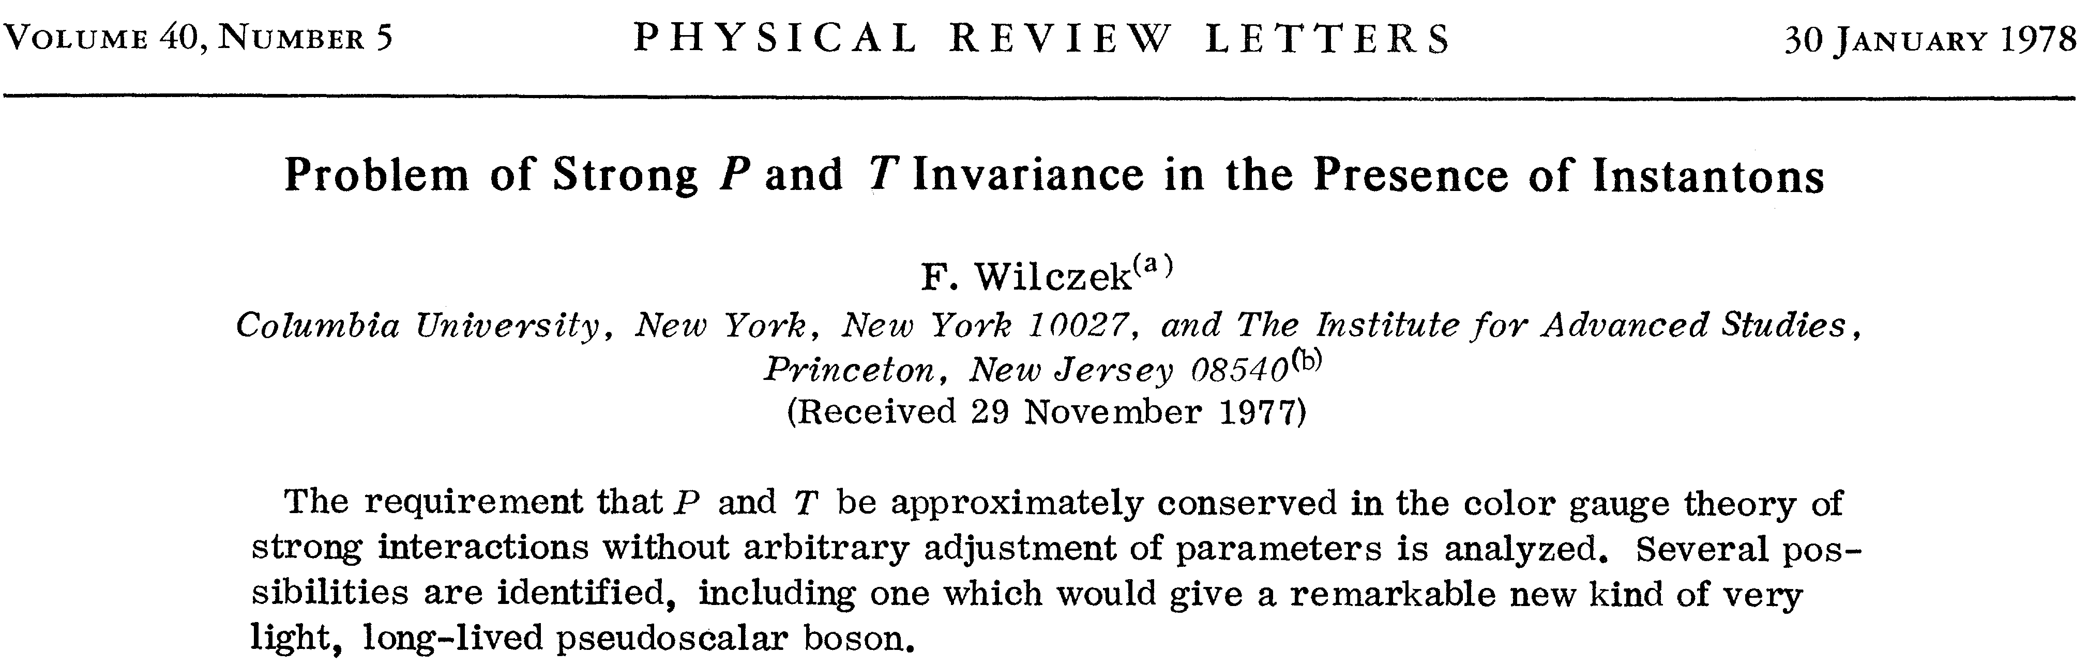
http://prl.aps.org/abstract/PRL/v40/i4/p223_1
http://prl.aps.org/pdf/PRL/v40/i5/p279_1

Slide 49

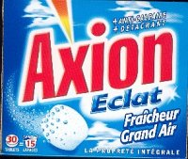
The story of the axion
A zero neutron electric dipole moment implies lack of CP-violation in QCD (has been measured)
This anomalous result needs a cause, since there is NO reason NOT to have CP-violation in QCD
Roberto Peccei & Helen Quinn proposed a symmetry which gives an origin for the lack of CP-violation in QCD
Wilczek and Weinberg then noticed this symmetry leads to a new pseudoscalar boson: the AXION (named after a laundry detergent)
“One needed a particle to clean up a problem…”
-- Frank Wilczek

Slide 50
άξιον = worthy, deserving

Slide 51
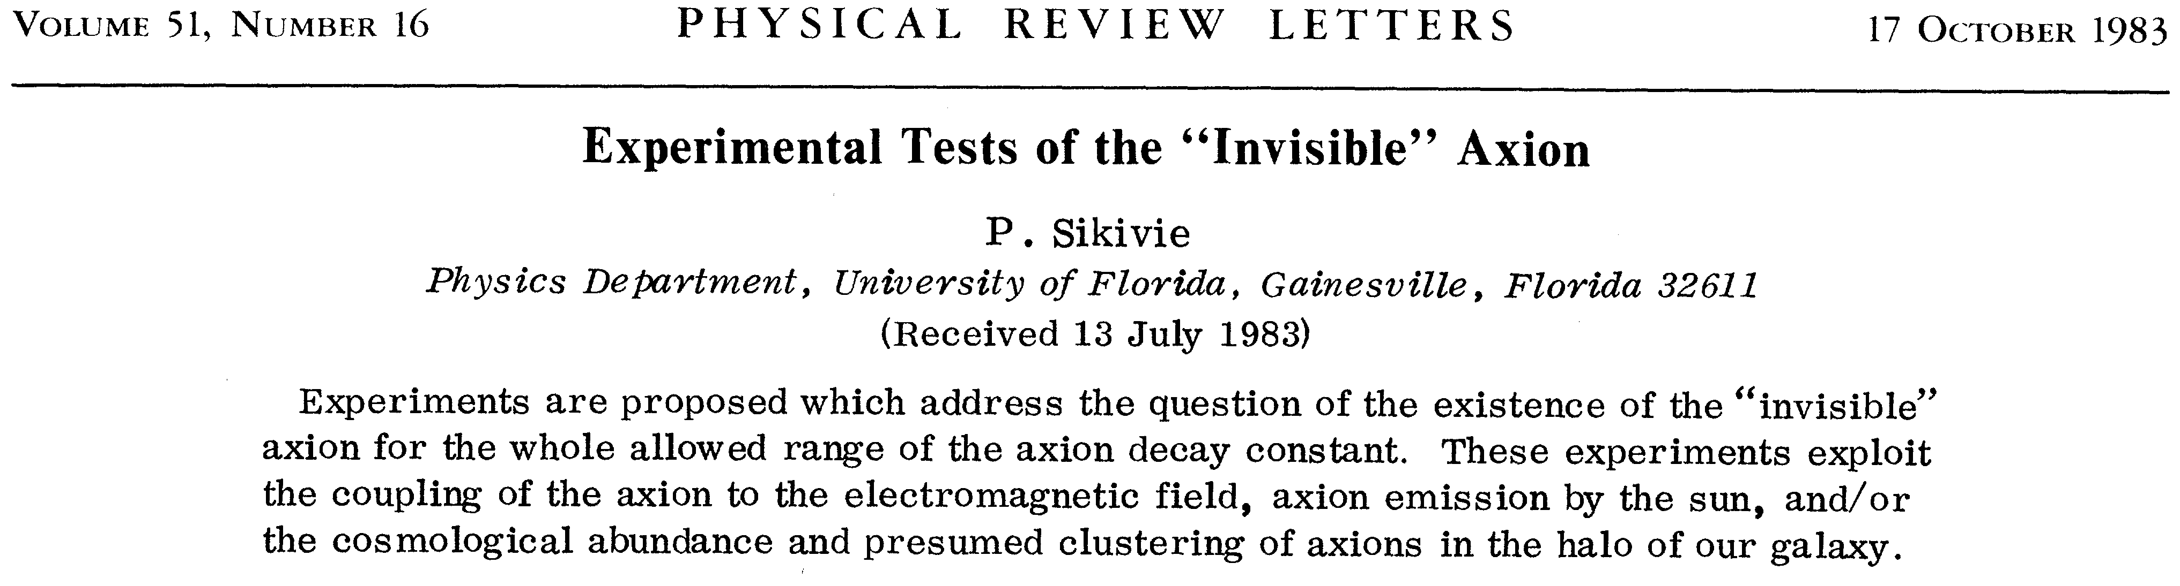
http://prl.aps.org/pdf/PRL/v51/i16/p1415_1

Slide 52
before CAST:
➔ BNL & Tokyo (Sumico) >>> CAST (…1/X)
➔ solar axion-Bragg @ Ge, NaI, …
➔ by-product from…
…cryogenic Dark Matter Search!

Slide 53
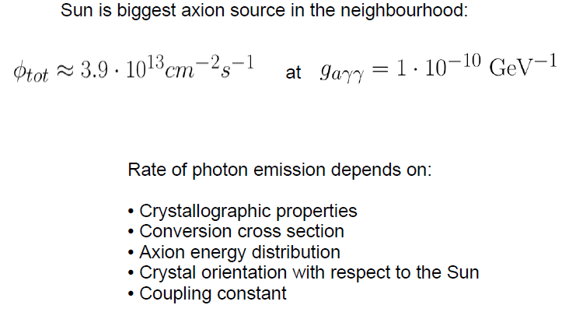
Solar axions
http://www.mpi-hd.mpg.de/gerda/lngs08/lngs08_slides/wednes/LNGS08axionsearch.pdf

Slide 54
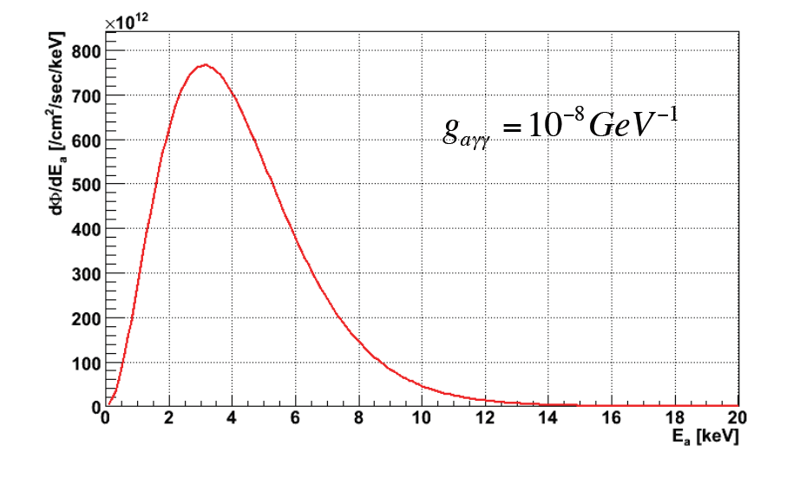
Solar Axion analog spectrum: g_{aγγ} coupling
Particle Physics Seminar, CERN, Jonghee Yoo (Fermilab)

Slide 55
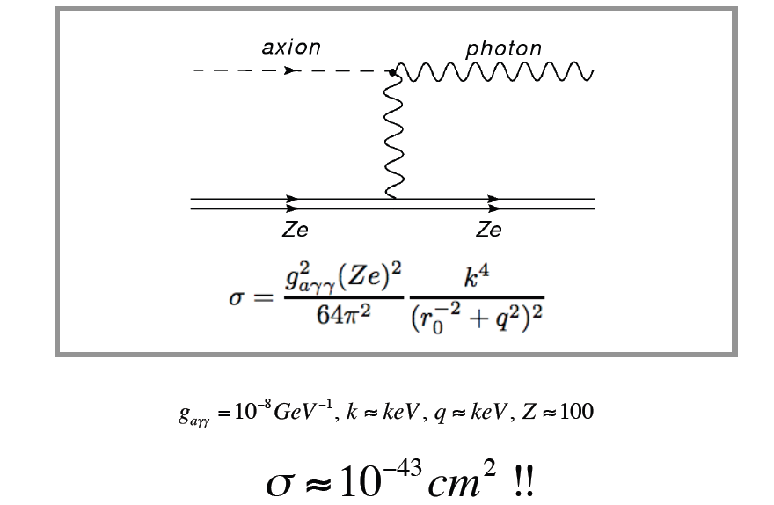
Axion-photon conversion : Primakoff effect
Particle Physics Seminar, CERN, Jonghee Yoo (Fermilab)

Slide 56
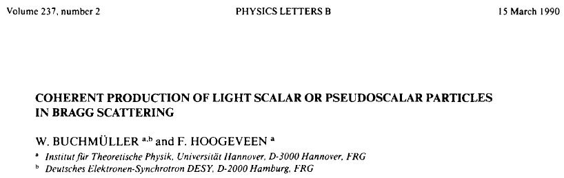
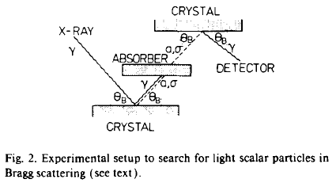

Bragg scattering 2x
Lab experiment: still interesting!

Slide 57
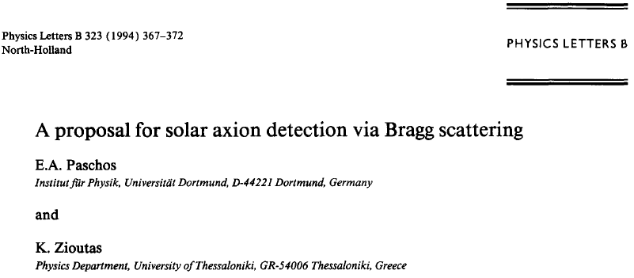





Axion helioscope: aBragg
axion
a
γ
crystal
σ = 1.46·10⁻⁴⁷ cm²
for g_{aγγ} =10⁻¹⁰GeV⁻¹
RE-evaluation of underground DM data!
mfp=?
See R.J. Creswick et al., Phys. Lett.B427 (1998) 235 >> theory!doi:10.1016/S0370-2693(98)00183-X

Slide 58


Crystal and Bragg Scattering
Coherent scattering of an axion in a crystal
Bragg condition
Particle Physics Seminar, CERN, Jonghee Yoo (Fermilab)

Slide 59

Expected conversion rates
http://www.mpi-hd.mpg.de/gerda/lngs08/lngs08_slides/wednes/LNGS08axionsearch.pdf

Slide 60


aBragg
nλ=2d sinΘ_{Bragg}
http://www.mpi-hd.mpg.de/gerda/lngs08/lngs08_slides/wednes/LNGS08axionsearch.pdf

Slide 61

aBragg
R.J. Creswick et al., Physics Letters B 427 (1998) 235 >> theory!
doi:10.1016/S0370-2693(98)00183-X

Slide 62
aBragg
Crystalline underground dark matter detectors
SOLAX, COSME, DAMA, CDMS,...
➔ a new axion helioscope for m_{axion} <1 keV/c²!

Slide 63


aBragg
SOLAX Collaboration
A single crystal Ge detector. The analysis of 1.94 kg·yr of data
from the 1 kg DEMOS detector in Sierra Grande, Argentina.
→ COSME, DAMA,CDMS, ...
http://prl.aps.org/pdf/PRL/v81/i23/p5068_1

Slide 64


aBragg
COSME
DAMA

Slide 65


aBragg
http://prl.aps.org/abstract/PRL/v102/i1/e011301
CDMS

Slide 66


aBragg
...15 years later
cover page of PRL
Time-energy plot of the expected event rate for finding photon-converted solar axions with a germanium detector.
Z. Ahmed et al. ,CDMS, Phys. Rev. Lett. 103, 141802 (2009)
CDMS
Energy →
Time of the day →

Slide 67
aBragg
In Cryogenic Dark Matter Search ➔
@ 10 - 100 mK
Particle Physics Seminar, CERN, Jonghee Yoo (Fermilab)

Slide 68

Direct Detection of Dark Matter → WIMPs
WIMPs (Weakly Interacting Massive Particles)
coherent scatter from the entire nucleus
© Michael Attisha
Particle Physics Seminar, CERN, Jonghee Yoo (Fermilab)

Slide 69
aBragg
Also for axion Search via axion-Bragg?

Slide 70


CDMS Detector
380μ x 60μ aluminum fins
1 μ tungsten
~10mK
R
Quasiparticle
diffusion
Transition Edge
Sensor
Al
Electro Thermal Feedback
T
Tc~80mK
Ge or Si
phonons
Particle Physics Seminar, CERN, Jonghee Yoo (Fermilab)

Slide 71


Photon Background
Yield = E(ionization) / E(recoil)
Electron Recoils
E_{r}
Photons
β ≈ 0.3
γ
More ionization
Electrons
Nuclear Recoils
Neutrons
E_{r}
β ≈ 7×10⁻⁴
Less ionization
χ⁰
, n
Particle Physics Seminar, CERN, Jonghee Yoo (Fermilab)

Slide 72

CDMS Dark Matter Search Result
?
Is it over ?
Particle Physics Seminar, CERN, Jonghee Yoo (Fermilab)

Slide 73

Solar Axion Detection Principle
Blackbody photons
in the Sun
X-ray detector
Coulomb Field
axions
The Earth
The Sun
Particle Physics Seminar, CERN, Jonghee Yoo (Fermilab)

Slide 74


Axion Detection Principle
Laser
Magnet
PMT
GammeV@FNAL
PRL100,080402(2008)
Particle Physics Seminar, CERN, Jonghee Yoo (Fermilab)

Slide 75


CDMS: Direction of the crystal plane
Ge crystal structure: fcc
Error in the direction measurement : 3º
Latitude : 47.815°N
Longitude : -92.237°E
Altitude : -210m
North
Particle Physics Seminar, CERN, Jonghee Yoo (Fermilab)

Slide 76

aBragg
CDMS
http://www.physik.unizh.ch/groups/groupbaudis/darkmatter/conf_proceedings/idm08_proceedings_tbruch_solaraxion.pdf

Slide 77


Time Variation of Expected Rate

Slide 78

aBragg
Expected Solar Axion Event Rate
CDMS
Particle Physics Seminar, CERN, Jonghee Yoo (Fermilab)

Slide 79

aBragg
CDMS Low Energy Gammas
Unbinned Likelihood Fit
Particle Physics Seminar, CERN, Jonghee Yoo (Fermilab)

Slide 80

DAMA Apparatus
aBragg
NaI scintillator array
  25 crystal, each 9.7 kg, 10 cm x 10 cm x 25.4 cm
  Each crystal viewed by 2 PMTs through suprasil-B
  lightguides, 5.5-7.5 photoelectrons/keVee
  Detectors separated by significant amounts of Cu!
Shield:
  > 10 cm Cu
  15 cm Pb + Cd foils (Cd for neutron capture gammas)
  10 cm polyethylene, 40 cm paraffin
  no surrounding scintillator veto!
Cleanliness
  Extreme efforts taken to avoid contamination
  Etching followed by HP N2 atmosphere
  Installation in N2 atmosphere using breathing
  apparatus
Have to give ‘em credit for hard work...

Slide 81


aBragg
The First Solar Axion Limit from CDMS + Solax,COSME, DAMA,
The paper is on the archive arXiv:0902.4693 (submitted to PRL)
Particle Physics Seminar, CERN, Jonghee Yoo (Fermilab)

Slide 82
aBragg future?
➔

Slide 83
aBragg
Solid Xenon
Phonons
~100 meV/ph
Why Xenon ?
• No long-lived Xe radio isotope (no intrinsic background)
• High yield of scintillation light
• Scintillation wavelength : 175nm (optically transparent)
• Relatively high melting point : T_{m} = 161K
• Simple crystal structure : fcc (same with Ge)
• Easy purification (distillation, etc)
• Self shielding : Z=54
Scintillation
~100 eV/γ
Ionization
~10 eV/el
Why Solid ?
• For solar axion search, being a crystal is crucial (Bragg scattering)
• Even more scintillation light (61 γ/ keV) than LXe (42 γ/ keV)
• Drifting electrons easier in the crystal
• Superb low noise superconducting sensors are running at low temperature (mK ~ K)
• Phonon read out : largest number of quanta (~10,000 phonons / keV)
- In principle best energy resolution can be achieved in phonon channel
- Luke-phonon readout will provide ionization energy and position information
• No further background contamination through circulation loop
• Optimal detector design for low background experiment
- Possible container free design
- No outgassing issue
Particle Physics Seminar, CERN, Jonghee Yoo (Fermilab)

Slide 84


aBragg
Key to Future Solar Axion Searchs
Particle Physics Seminar, CERN, Jonghee Yoo (Fermilab)

Slide 85
aBragg
Signal readout and larger crystal
1. Scintillation / Ionization readout
- scintillation readout using standard photon sensors
- ionization readout by drifting electrons (grid mash method)
- use phase-I safety chamber (new quartz vessels, new flange)
- xenon purification systems (O₂ / H₂O …)
2. Demonstrate large solid xenon crystal growth (~10 kg)
- make a full prescription for growing large solid xenon
- crystal orientation measurement
3. Design 10 kg phase prototype experiment
Particle Physics Seminar, CERN, Jonghee Yoo (Fermilab)

Slide 86
“aBragg” ?
Note: aBragg scattering → E_{γ,a}>1-2 keV
E_{γ,a}<1-2 keV ?? ➔ solar analog spectra increase with decreasing E
➔ Refractive Grating Spectrometer from X-ray astronomy?
➔ a ↔ γ interference?
>> under investigation with others.
➔ exercise!?

Slide 87

Schematic layout of the RGS / XMM-Newton
646 grooves/mm
→ solar paraphotons?
➔ exercise!?
http://xmm.esac.esa.int/external/xmm_user_support/documentation/technical/RGS/

